Slide 1
Avaya Scopia Video Collaboration Overview
June 2014

Slide 2
The Speed of Business is Accelerating Requires new internal and external collaboration tools
BYOD
SOCIAL
MOBILITY
Enterprise
ECONOMY
POLICY
Customers
Users
CLOUD
Point of
Customer Service
Point of
Employee Productivity
Notes:
Speed is an overarching issue across your organization. This slide is your organization. Where communication and collaboration technologies are needed to target and enable each unique group with the right experiences and tools to address roadblocks to time-to market, competitive leadership and satisfied customer groups.
Within each of our organizations the speed of business is not just tied to one technology or group of people. We all move at the speed of the slowest parts of our key business processes. Whether it’s customer service, operations, supply chain or new development.
To successfully meet business goals speed needs to be entrenched across all interaction and delivery points, from production to distribution to the point of sale and customer service.
You need all of the pieces working together at the same speed, with the same efficiency to achieve desired results and returns.
At Avaya we believe that targeting faster real-time collaboration across the enterprise for the right users and key processes is the best way to ensure rapid results.
Our methodology is to start by understanding how high priority processes are being driven by today’s business priorities – which are changing significantly with market dynamics including, economic, social, technical trends like cloud, policy and mobility and of course BYOD.
The question for businesses is are you bottlenecked in your ability to develop new products and services or easily able to respond to customer and competitive demands.
Is it easy for your business to train new channels and use new media and modes of communication or are these key elements of your organization constrained?

Slide 3
Key Market Requirements for Effective Video Collaboration
Desktop / Mobility / BYOD
75% of companies are supporting, planning to,
or evaluating supporting video conferencing on mobile devices.*
Need to be able to invite anyone into a conference.
Uncompromised Quality
1080p is the new HD
55% of all internet traffic is video – requires advanced QOS
Bandwidth utilization is more important than ever.
Open and Interoperable
Customers don’t want proprietary or closed systems
Platform interoperability is key part of decision process
Integration with Unified Communications essential
Simple and Affordable
Cost and complexity has historically slowed deployment.
SMB market requires a simple and affordable solution.
Manageable
System wide management for simple administration
Simple ad-hoc and scheduled conferencing
* Nemertes Research: Pervasive Video Collaboration Benchmark Report 2013
Notes:
Here are the key market requirements for effiective video collaboration
(review each and supporting proof point)
Desktop / Mobility / BYOD:
1 Nemertes Research: Pervasive Video Collaboration Benchmark Report.pdf
3

Slide 4
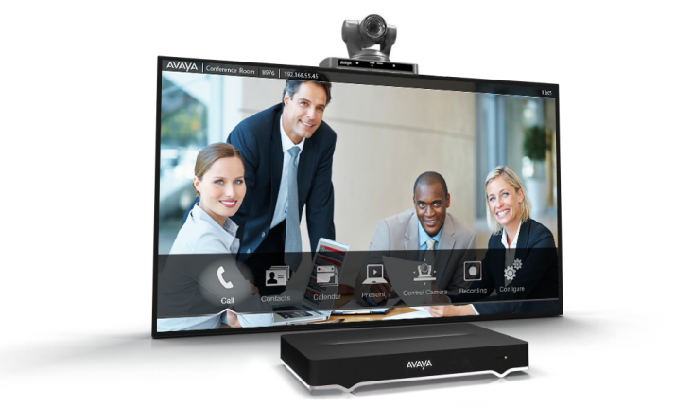
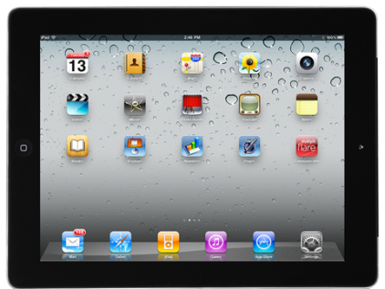
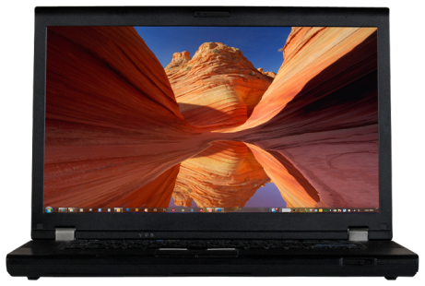
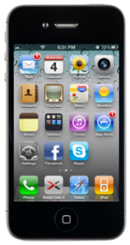
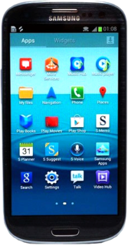
Enterprise Video Meets Mobile Collaboration
23% of companies have deployed desktop video to 50% of their employees*
40% of employees spend 20% of time away from the office†
Video capability included in 60% of UC client deployments by 2016‡
80% Fortune 100 deploying iPhones/iPads§
71%
of enterprises expect to integrate desktop/mobile video with rooms
Nemertes Research 2013
94%
of respondents say video collaboration improves efficiency and productivity
Wainhouse 2013
* Nemertes DN2924 Pervasive Video Collaboration Benchmark Report 2013 † Gartner IT Symposium 2011
‡ Gartner Market Trends: Videoconferencing Worldwide 2012 August 2012. G00229598 § Steve Jobs, Apple Press Event, March 2011
Notes:
It’s all about desktop and mobile video collaboration. Let’s look what’s trending
71% of enterprises expect to integrate desktop / mobile video with rooms. Nemertes DN2924 Pervasive Video Collaboration Benchmark Report 2013
94% of respondents say video collaboration improves efficiency and productivity (Wainhouse, The Real Benefits of Using Video, 2013)
*Desktop video conferencing deployments are increasing rapidly… going away from the room. 23% of companies have deployed video to more than half of their employees, up from 9% who had deployed that extensively in 2012. 43% have deployed to more than 2% of their employees, up from 28% in 2012. Nemertes DN2924 Pervasive Video Collaboration Benchmark Report 2013
† 40% employees spend 20% of time away from office. Gartner IT Symposium 2011
‡ Video capability will be included in 60% of UC client deployments by 2016” . Gartner Market Trends: Videoconferencing Worldwide 2012 August 2012. G00229598
§ 80% OF FORTUNE 100 COMPANIES ARE DEPLOYING PHONES AND IPADS. Steve Jobs, Apple Press Event, March 2011

Slide 5
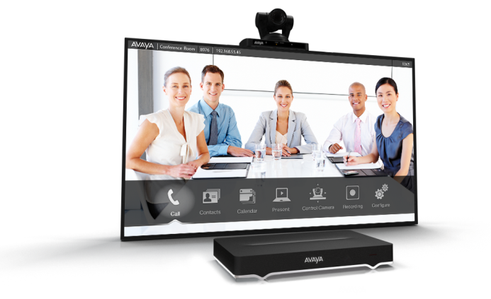
Market Outlook
10.5% Video Endpoint Systems CAGR through 2017
46% Growth in soft clients
Video endpoints systems* growth 10.5% CAGR (2012-2017) *single codec Wainhouse 2013
Personal video growth 25% CAGR (2011-2017) Wainhouse 2013
Dedicated soft clients video licenses growth 46% CAGR (2011 – 2016) Gartner 2012
Video as a Service growth 43% CAGR (2013-2016) Gartner 2012
Video conferencing rated as top priority investment Gartner 2013
Notes:
A look at the Market - while traditional video room systems continue to grow, the dramatic growth is in soft clients , personal video , and Video as a Service (VaaS)
Video Endpoint Systems growth 10.5% CAGR (2012-2017) Single Codec Units.
Source: Wainhouse Video Conferencing Endpoints, Infrastructure and Services Market Sizing & 5 year forecast 2013 Q3 2013 – Update (confirmed)
Personal video growth 15% CAGR (2011-2017) Wainhouse 2013
Dedicated soft clients video licenses growth 46% CAGR (2011-2016) Gartner Market Trends: Videoconferencing Worldwide, 2012
VaaS growth 43% CAGR (2013-1016) Gartner Market Trends: Videoconferencing Worldwide, 2012
Videoconferencing rated as top priority investment: Gartner 2013
As of last year, about 25% of companies used tablets for corporate work. In more recent research, an astounding 41% said mobile video support was important to them and 21.7% rated this support as critical. The bottom line is that mobility is where video is headed. Nemertes What's driving video interest and funding growth of video platforms? I. Lazar, 2013
Rev date March 2014

Slide 6
Top Five Networking Investment Initiatives
What are the top five investment initiatives for your organization in the area of networking and communications in the next 12 months?
Notes:
Web conferencing, video conferencing and UC all make up the top five investment initiatives.
Over 30% of midsize enterprises surveyed indicated these 5 will be investment priorities for their organization.
Audio conferencing has a much lower priority.

Slide 7
Radvision Solutions Added to Avaya Portfolio The most comprehensive and interoperable solution in the market today
Leveraging 20-Years of Expertise in Video
The Video industry runs on Radvision technology
Market Share Leader in core signaling technologies
Video Infrastructure supplier to the industry’s largest companies
History of innovation with strong patent portfolio
Scalable Video Coding (SVC)
Distributed Multipoint Architecture
Bandwidth Optimization
Mobile Video Telephony
Conference Initiation from IM
Integration with Avaya portfolio continues
Acquired by Avaya in June 2012
Award-winning Scopia video collaboration solutions add to Avaya UC portfolio for partners and customers
Notes:
Highlight the history and expertise of Radvison, which was acquired by Avaya in June 2013
With Avaya Scopia, we now offer a complete video conferencing solution available for you to sell today. We offer real time and scheduled video conferencing with video client s/w for PCs, iPhones, and iPADS and pull through for Avaya collaboration and data networking.
Scopia gives you the ability to talk to customers about connecting their existing video systems which are predominantly still based on the H323 protocol stack and provide a bridge to the future of mass deployed, personal video which will be based on the SIP standard. RADVISION supports both H323 and SIP based video conferencing solutions enabling you to interoperate with what customers already have.
Scopia provides a great user experience for video conferencing and content sharing across meeting room systems and desktop and meets the Bring Your Own Device trend with client s/w for Apple devices. Scopia also provides your customers the ability to control, manage, schedule and monitor performance for their entire video network including 3rd party video equipment.
7

Slide 8
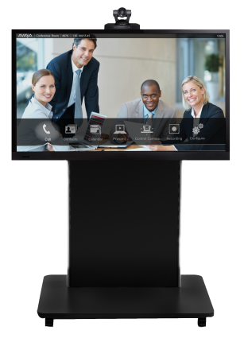
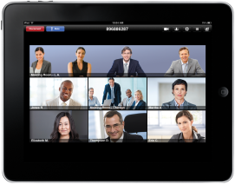
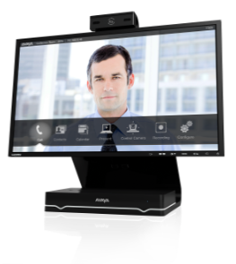
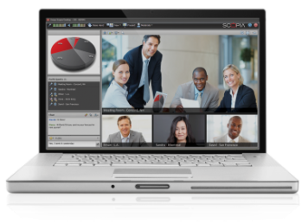
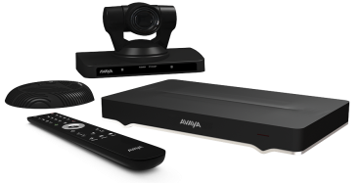
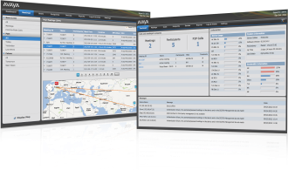
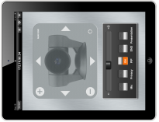
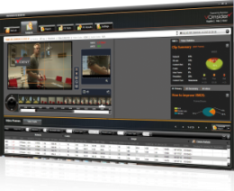
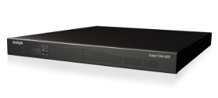
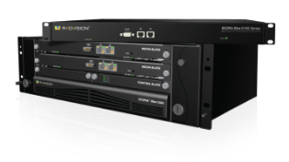
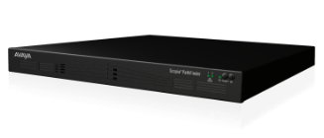
Avaya Scopia Video Collaboration A complete video solution portfolio
Video Collaboration Endpoints
Scopia XT Telepresence Platform
Scopia Meeting Center
Scopia Desktop
Scopia Mobile
Scopia XT 4000/5000
Scopia XT Executive
Video Collaboration Infrastructure, Management, Control
Scopia Management
Scopia Control
Scopia Elite 6000
Scopia Elite 5000
Scopia Pathfinder Firewall Traversal
Scopia Video Gateway for Microsoft Lync
Scopia Evident
Notes:
Scopia offfers a complete video conferencing solution available for you to sell today. We offer real time and scheduled video conferencing with video client s/w for PCs, iPhones, and iPADS and pull through for Avaya collaboration and data networking.
Scopia gives you the ability to talk to customers about connecting their existing video systems which are predominantly still based on the H323 protocol stack and provide a bridge to the future of mass deployed, personal video which will be based on the SIP standard.
Avaya Scopia (RADVISION) supports both H323 and SIP based video conferencing solutions enabling you to interoperate with what customers already have.
Scopia provides a great user experience for video conferencing and content sharing across meeting room systems and desktop and meets the Bring Your Own Device trend with client s/w for Apple devices. Scopia also provides your customers the ability to control, manage, schedule and monitor performance for their entire video network including 3rd party video equipment.
8

Slide 9
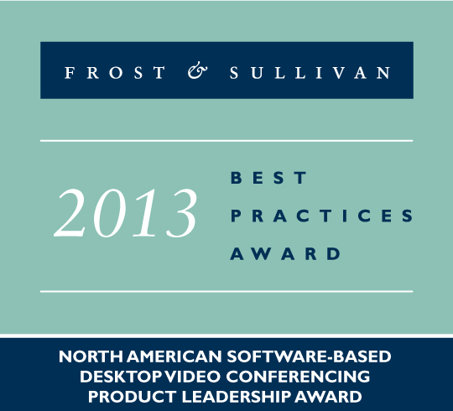
Scopia Industry Awards
Avaya Earns Top Provider Award for Enterprise Video Conferencing Nemertes 2014 PilotHouse Top Provider, Video Conferencing Enterprise
Value and technology boost Avaya to Top Provider for Video Conferencing for the enterprise segment. Pricing, licensing clarity and a strategic roadmap drive this top ranking, align with customer requirements and make Avaya customers among the most loyal of ranked vendors.
Read the News Release
Winner, Best Deal for SMB: Avaya Video Collaboration Solution for IP Office InfoComm 2013 Best of Show Award, Telepresence Options
The flexibility of the Scopia platform never ceases to amaze … (with) an infrastructure appliance capable of supporting a small desktop and mobile VC deployment.
Radvision Awarded Champion Status Info~Tech 2013 Video Conferencing Vendor Landscape
Radvision’s solutions may be the best option for on-the-go users, with Avaya Aura and Scopia providing enhanced tablet and smartphone user engagement.
Info~Tech 2013 Video Conferencing Vendor Landscape Award
Read the Report
Scopia Desktop Earns Frost & Sullivan Product Leadership Award for Desktop Video Conferencing Product Leadership
Scopia Desktop outperformed the competition in Quality and Value … (with a) blend of innovative functionality and proven technology that are difficult to match.
Frost & Sullivan 2013 Best Practices Award North American
Read the News Release

Slide 10
Industry Analyst Ratings
The Forrester Wave™:Desktop Videoconferencing The inaugural Forrester Wave on desktop video is out, and the results are impressive. We all know that Scopia Desktop and Mobile are fantastic solutions and a competitive differentiator for Avaya. The Forrester Wave for Desktop Videoconferencing reinforces our leadership position.
Gartner MarketScope for Group Video Systems 2013
Great news! Avaya moved from the “Promising” rating to “Positive” in this year’s Gartner MarketScope for Group Video Systems.
According to Gartner Vendors issued a Positive rating Demonstrates strength in specific areas, but execution in one or more areas may still be developing or inconsistent with other areas of performance:
Customers: Continue planned investments
Potential customers: Consider this vendor a viable choice for strategic or tactical investments, while planning for known limitations
Read the report to see what Gartner has to say about Avaya.
Source: Forrester Research, Inc.
Avaya Customer Sentiment Survey Q1FY13 | CSAT | NPS
Radvision Scopia Desktop and Mobile Applications | 4.11 CSAT: 1 (worst)  5 (best) | 80 NPS: 50 (out of 100) = Best in Class

Slide 11
Avaya Scopia Video Collaboration Portfolio

Slide 12
The Best Desktop, Mobile, BYOD Solution
Unlimited Free Mobile and Desktop clients
HD Voice, Video and Data
Automatic Firewall Traversal
Optimized for Internet
Enterprise Integrated
Not Just a Video Endpoint
Moderate your Meetings
Start Streaming or Recording
Call from your Directory
Control your Layouts
Avaya Scopia Desktop & Mobile

Slide 13
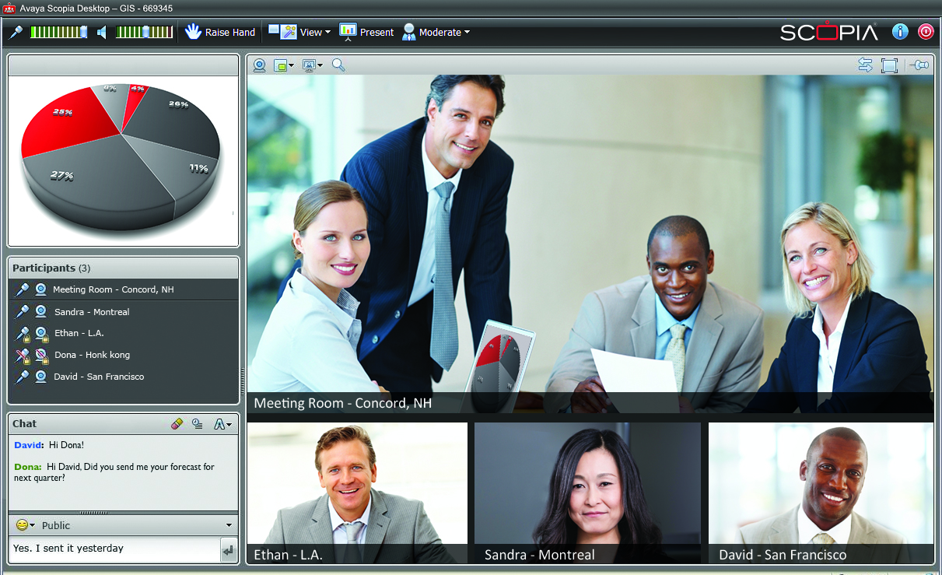
Avaya Scopia Desktop & Mobile / Mobile vs. LifeSize, Polycom, Vidyo
PC/Mac Desktop Client | ✓ | ✓ | ✓ | ✓
A/V/D Mobile Client (iOS / Android / Smartphone / Tablet) | ✓ | ✓ | ✓ | ✓
Easy to Invite Guests (No Keys) | ✓ | ✗ | ✗ | ✓
Embedded Firewall Traversal | ✓ | ✗ | ICE | ✓
Native Room System Support | ✓ | ✓ | Needs Gateway | ✓
Telepresence Interoperability | ✗ | ✓ | ✗ | ✓
Data Interoperability (H.239) | ✓ | ✓ | Needs Gateway | ✓
H.239 Data Review (Slider) | ✗ | ✗ | ✗ | ✓
Max. Users in Video Layout | 4 | 16 | 8 Desk / 4 Mob. | 28
Full Moderation & Control | ✗ | ✗ | ✗ | ✓
Device Calendar Integration | ✗ | ✗ | ✓ | ✓
Internet Optimized (esp. Wireless) | ✗ | ✓ | ✗ | NetSense, SVC (SVC on Desktop only)
✗ Not Supported ✓ Supported
Notes:
This chart compares the Scopia Desktop and Mobile solutions to Polycom’s desktop and mobile solution, LifeSize ClearSea (previously called Mirial), and Vidyo’s desktop and mobile capabilities.
Why is the Scopia Desktop and Mobile solution better? First, none of the competitor’s products provides the slider reviewing previously presented materials without interrupting the presenter. Scopia provides the highest number of users that can be viewed simultaneously in a video layout. And only Scopia provides full conference moderation and control.
Native room system support is an advantage over the Vidyo solution, which requires a gateway.

Slide 14
Avaya Scopia Desktop / Mobile vs. Jabber, Webex, Skype
 | Jabber
PC/Mac Desktop Client | ✓ | ✓ | ✓ | ✓
A/V/D Mobile Client (iOS / Android / Smartphone / Tablet) | ✓ / ✓/✓ / ✓ | ✓ / ✓/✓ / ✓ | No multi-party video | ✓
Easy to Invite Guests (No Keys) | ✗ | ✓ | ✓ | ✓
Embedded Firewall Traversal | ✗ | ✓ | ✓ | ✓
Native Room System Support | ✓ | ✗ | ✗ | ✓
Telepresence Interoperability | ✓ | ✗ | ✗ | ✓
Data Interoperability (H.239) | ✓ | ✗ | ✗ | ✓
H.239 Data Review (Slider) | ✗ | ✗ | ✗ | ✓
Max. Users in Video Layout | 20 | 7 Desk / 5 Mob. | 10 | 28
Full Moderation & Control | ✗ | ✓ | ✗ | ✓
Device Calendar Integration | ✓ | ✓ | ✗ | ✓
Internet Optimized (esp. Wireless) | ✓ | ✗ | ✗ | NetSense, SVC (SVC on Desktop only)
✗ Not Supported ✓ Supported
Notes:
Here, we see a comparison of Scopia Desktop and Mobile solutions to Cisco Jabber Telepresence (previously called Movi), Cisco’s WebEx, and Skype.
The main areas of differentiation against the competitors include points we just mentioned: none of the competitor’s products provides the slider reviewing previously presented materials, and Scopia provides the highest number of users that can be viewed simultaneously in a video layout.
In addition, Jabber Telepresence doesn’t support Android or any smart phone; it also doesn’t support embedded firewall traversal. For the services from WebEx and Skype, bandwidth utilization is inefficient for video, and there is no room system support. Skype has mobile clients that support point-to-point video, but they don’t support multi-party video.

Slide 15
Avaya Scopia Desktop and Mobile vs. Microsoft Lync
PC/Mac Desktop Client | ✓ | ✓ | ✓
A/V/D Mobile Client (iOS / Android / Smartphone / Tablet) | IM/Presence only No Android Tablet Support | ✓ | ✓
Easy to Invite Guests (No Keys) | ✗ | ✗ | ✓
Embedded Firewall Traversal | ✓ | ✓ | ✓
Native Room System Support | ✗ | ✗ | ✓
Telepresence Interoperability | ✗ | ✗ | ✓
Data Interoperability (H.239) | ✗ No H.239 but has document collaboration | ✗ No H.239 but has document collaboration | ✓
H.239 Data Review (Slider) | ✗ | ✗ | ✓
Max. Users in Video Layout | 2 | 5 Desk / 1 Mobile | 28
Full Moderation & Control | ✗ | ✗ Partial controls | ✓
Device Calendar Integration | ✓ | ✓ | ✓
Internet Optimized (esp. Wireless) | ✗ | ✗ Partial (H.264 SVC but lacks added techniques) | NetSense, SVC (SVC on Desktop only)
2010
2013
✗ Not Supported ✓ Supported
Notes:
This chart compares the Scopia Desktop and Mobile solutions to Microsoft Lync 2010 and 2013.
There are a number of shortcomings with Microsoft Lync. Lync does not offer native room system support and generally requires a gateway. In addition, it doesn’t offer H.239 data interoperability with room systems or any slider-like capabilities for reviewing previously presented materials. And the number of users that can be viewed simultaneously in a video layout is extremely limited with Lync.
So while Microsoft Lync offers a full unified communications client, its video capability is limited—whereas Scopia® offers a rich video solution that includes content-sharing with native interoperability with room systems.

Slide 16
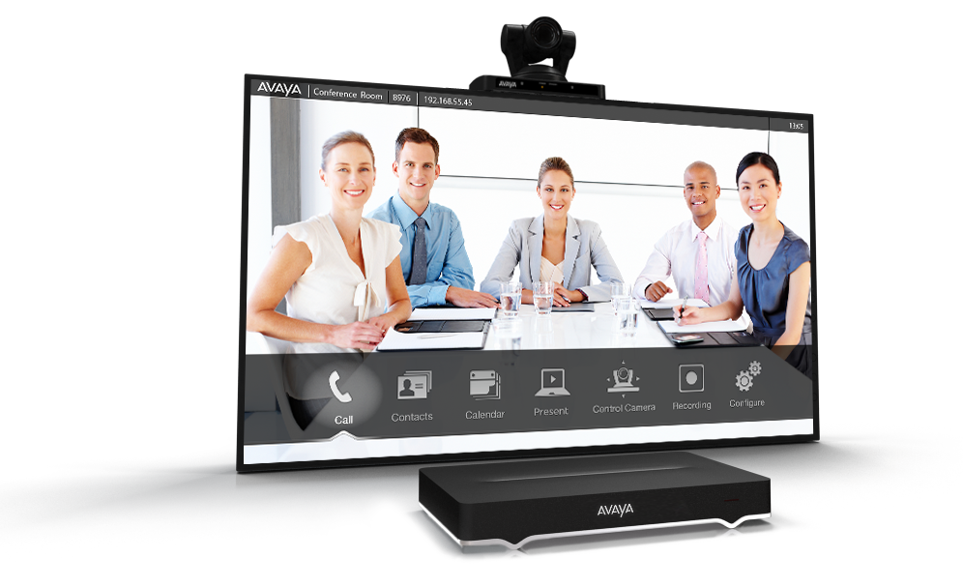
The Market’s Most Powerful Room System
Dual 1080/60fps for both Video & Content
H.264 High Profile & SVC
Intuitive User Interface
Unique iPad Control
Highest Capacity MCU
Streamlined Industrial Design
No other room system
in the market today
can do all of this!
Avaya Scopia XT 5000
Notes:
The Scopia XT5000 is Radvision’s flagship product in the Scopia series of HD video conferencing room systems. The XT5000 incorporates dual 1080p/60fps live video and content, HD audio, H.264 High Profile for bandwidth efficiency, H.264 Scalable Video Coding (SVC) for error resiliency, along with embedded multi-party calling with support for continuous presence with up to 9 participants which is the highest capacity in the market today.
The user interface is designed for simplicity along with Apple iPad control for enhanced capabilities and the XT5000’s refinement goes beyond the user experience to modern hardware design that complements any conference room.

Slide 17
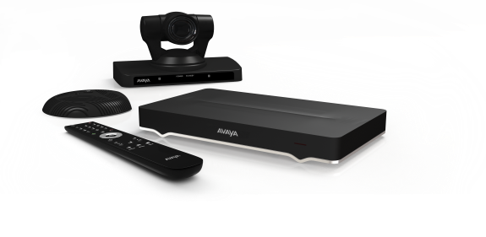
Avaya Scopia XT5000 Comparison
1080p60 Live Interactivity | ✓ | ✓ | ✗ | ✓
1080p60 Dual Presentation | ✗ | ✓ | ✗ | ✓
High Profile Bandwidth Efficiency | ✗ | ✓ | ✗ | ✓
SVC Any network | ✗ | ✓ | ✗ | ✓
9-Way MCU Small Business | ✗ | ✗ | ✗ | ✓
Desktop/Mobile Integrated Support | ✗ | ✗ | ✗ | ✓
Price-Performance
✗ Not Supported ✓ Supported
Bad
Great
Notes:
When you compare the features against the competition, the XT5000 is the clear winner. The XT 5000 is the only solution that provides the combination of content-sharing at 1080p60, multi-party conferencing with up to nine participants, and integrated desktop and mobile support.

Slide 18
The Most Affordable Premium Desktop
Integrated Scopia XT Platform with 24” LED PC Display
Available 1080/60fps for Video & Content
H.264 High Profile & SVC
Embedded Multi-Party Conferencing
Unique PC & Mac Control
Avaya Scopia XT Executive 240
Notes:
The Scopia XT Executive 240 integrates the advanced Scopia XT video conferencing platform with a high resolution 24-inch LED display. The system offers optional embedded multi-party conferencing for impromptu group meetings, unique HD 1080p for highly detailed content sharing and available simultaneous 1080p video for an outstanding experience. H.264 High Profile and H.264 Scalable Video Coding (SVC) deliver bandwidth efficient, high performance video collaboration over real world networks.

Slide 19
The Most Flexible & Affordable Telepresence
Totally Flexible Solution
No Restrictive Room Sizes
1/3 Cost of Competition
Highest Interoperability
Avaya Scopia XT Telepresence
Avaya Scopia Control
Notes:
The Scopia XT Telepresence Platform creates a lifelike, immersive experience replicating the feeling of meeting in-person. The XT Telepresence Platform is customizable to the unique requirements of individual rooms and customer needs. Installed and configured by Radvision and Avaya’s worldwide network of channel partners, the XT Telepresence Platform provides a cost-effective and highly flexible approach, enabling partners to meet the unique needs of each customer deployment. Customers can define the installation and furnishings that best fit within their conferencing environments for a distinct customized telepresence experience typically at 1/3 the cost of the competition.
Through the Scopia Elite MCU, Radvision offers the most interoperable, multi-vendor, multi-stream telepresence multi-party conferencing solution available.

Slide 20
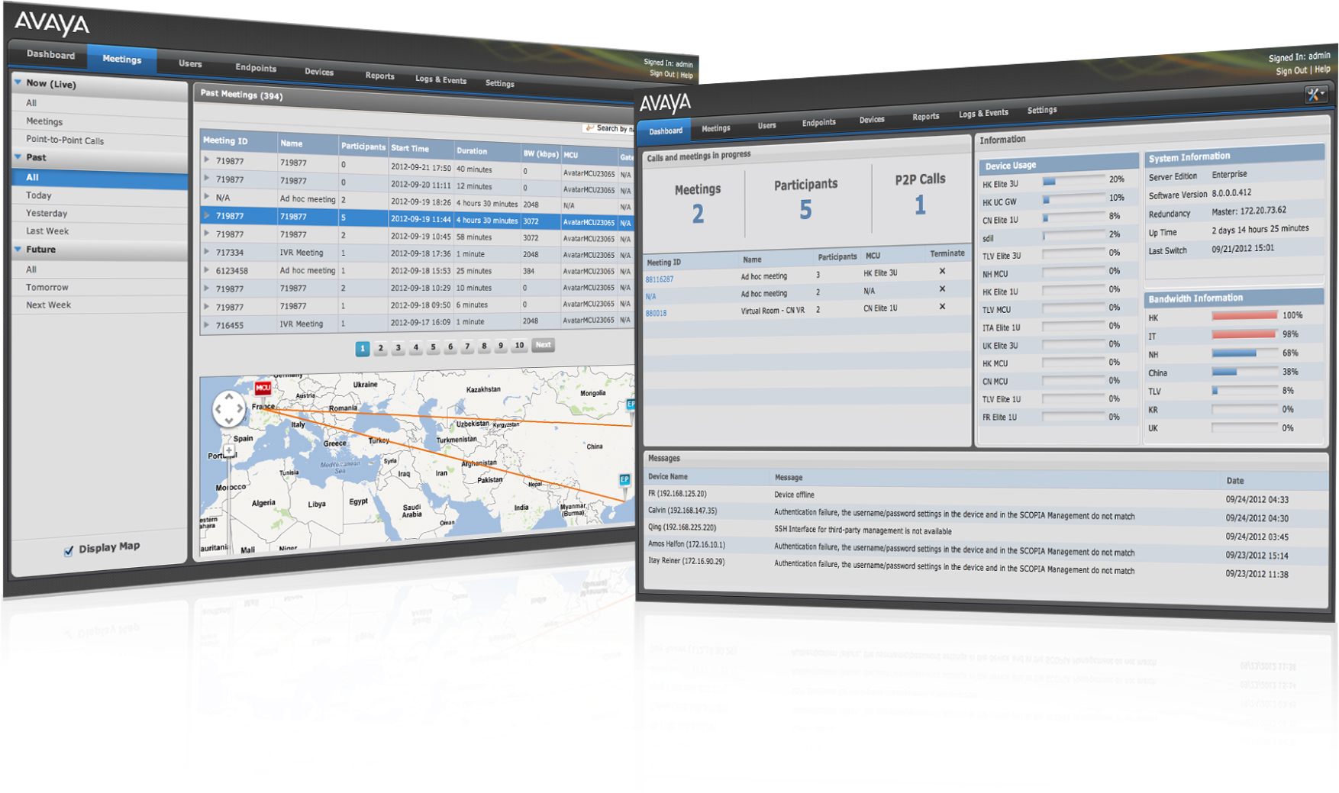
The Most Comprehensive Management Application
Single All-inclusive Solution
Broad 3rd Party Client Support
Patented MCU Virtualization
Virtual Rooms
Extensive Enterprise Back Room Integration
Avaya Scopia Management
Notes:
Scopia Management delivers management, control and scheduling for robust, easy-to-use conferencing via a simple browser-based interface.
The interface incorporates Google Maps providing a global geographic view of the collaboration topology along with multi-tenancy, concierge services, and massive scalability of up to 400,000 users for service providers and large enterprises.
Scopia Management provides an all-inclusive solution for managing all video conferencing devices including Radvision and third party endpoints, infrastructure devices such as MCUs and gateways, and call control applications such as gatekeepers and SIP agents. Administrators can detect and monitor their devices, remotely configure, control and upgrade them.
Scalability and redundancy is delivered for large enterprises and service providers including the unique Virtual MCU feature for distributed deployments. With Scopia’s Virtual MCU, virtual conference rooms are created for simple access across the deployment.
Extensive enterprise back room integration is available including integration with Microsoft Active Directory, Outlook and Lync or IBM Lotus Domino, Notes and Sametime.

Slide 21
Avaya Scopia Management Comparison
Single-Product Solution Comprehensive one-product solution | Requires 2+ products | Requires 2 products | ✓ | ✓
Multi-Vendor Management Third-party endpoint management | Very limited | Limited | ✓ | ✓
Virtualized MCU Resources Virtual conference rooms across distributed deployment | Scheduled only | Requires DMA | ✗ | ✓
Any Device / Any Browser Management access from anywhere | ✗ | ✗ | ✗ | ✓
Multi-tenant Solution for service providers | ✗ | ✓ | ✗ | ✓
Microsoft & IBM Integration Back office support | ✓ | MSFT Only | MSFT Only | ✓
Telepresence Management | Cisco Only | PLCM & Cisco TIP | ✗ | ✓
Users Supported | 100,000 | 10,000 | Not published | 400,000
Price-Performance
✗ Not Supported ✓ Supported
Bad
Great
Notes:
There are a few ways that Scopia Management beats the competition. Scopia Management is the only single-product solution provides full multi-vendor and third-party endpoint management and virtualized MCU resources. It’s also the only solution that enables administrators to manage the video deployment from any browser and any device, including Apple and Android smart phones and tablets. And, it supports far more users than competitor solutions.

Slide 22
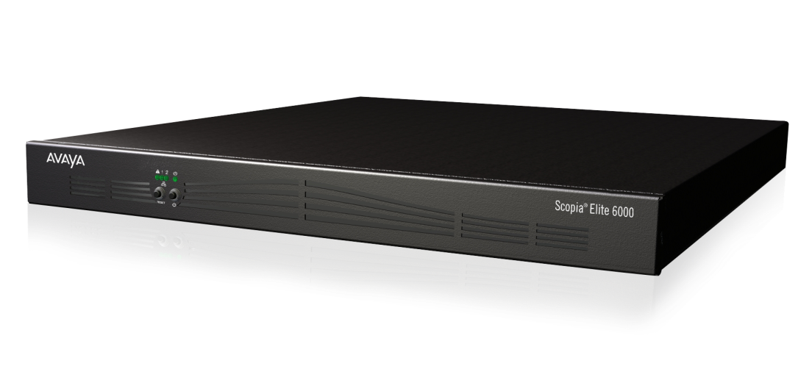
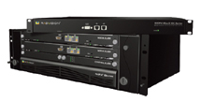
The Most Powerful MCUs in the Market
Hybrid Hardware / Software Architecture
Dual 1080p/60fps
H.264 SVC & High Profile
80 HD Ports in 1U
Desktop/Mobile/Room
24 Video Layouts
28 Participants on Screen
Telepresence Interop.
Avaya Scopia Elite 6000 Series
Scopia Elite 5000 Series

Slide 23
Avaya Scopia Elite 6000 Comparison
1080p60 Interactivity | ✗ | Partial | ✗ | ✓
High Profile Bandwidth efficiency | ✗ | ✓ | ✗ | ✓
SVC Any network | ✗ | Partial | ✗ | ✓
High Density 1080p per 1U | 20 | 15 | 8 | 40
High Density 720p per 1U | 20 | 30 | 8 | 80
Great
Price-Performance
✗ Not Supported ✓ Supported
Bad
Notes:
With 1080p60 video and content-sharing, High Profile and SVC, and way higher density—the Elite 6000 MCU is the clear winner.
The chart here shows that Polycom partially supports 1080p60. We say partial because the RMX MCU has an asymmetric implementation where it receives 720p60 video and sends 1080p60, whereas the Elite 6000 has symmetric 1080p60 video. The RMX MCU doesn’t support 1080p60 for the content channel, unlike the Elite 6000, which supports 1080p60 for both the live and content channels. The RMX also supports a data rate of only 4 Mbps, whereas the Elite 6000 supports up to 12 Mbps. This difference can be important in 1080p60 applications. And finally, Polycom’s support of 1080p60 applies to motion only; the Elite 6000 support of 1080p60 applies to both motion and sharpness.
In regard to Polycom’s “partial” support for SVC, there are a number of limitations and issues with Polycom’s implementation:
A multi-stream application has high bandwidth consumption with a 720p connection, consuming 1.5 Mbps.
Endpoints can only dial in; they cannot be invited from the MCU.
There is no cascading, so the maximum conference size is limited to 60 participants.
Content sharing is H.264 at only 720p5 frames per second.
The meeting moderator cannot control the video layout.
There is no encryption, no conference entry via IVR, and no conference recording capabilities.

Slide 24
Avaya Video Collaboration Solution for IP Office for SME
Room-based, desktop and mobile video collaboration solution
Creates a Virtual Conference Room
Specifically designed for small and midsize enterprises
Integrates exclusively with IP Office 8.1
Consumer-based Video
Avaya
Room-based Systems
Comprehensive, Simple, Affordable

Slide 25
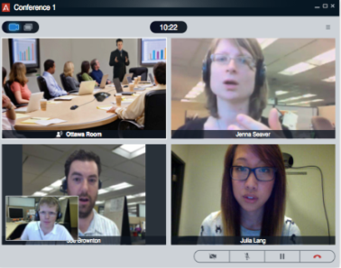
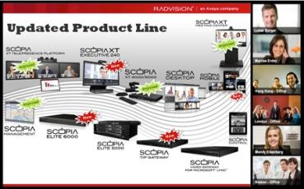
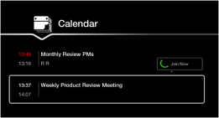
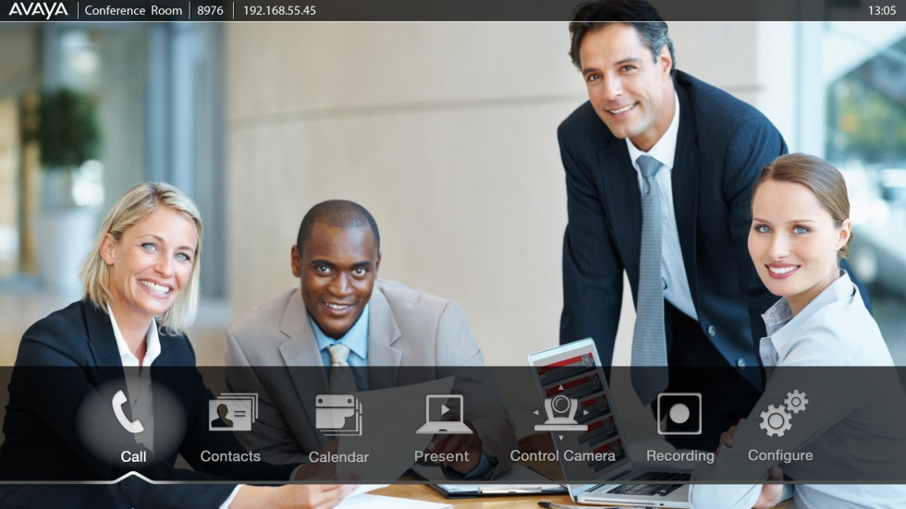
Avaya Scopia V8.3 – Enhanced Usability
1
View content and video simultaneously
“Gallery” video layout that provides combination of video and content
Flare, Lync, single display room systems, etc.
Devices which are not H.239/BFCP compatible
Much easier to join scheduled meetings from room systems
Join meeting without having to enter numbers
Calendar integration (Exchange)
Next meeting, Day in a glance
Manage meetings from Scopia room systems just like from Scopia Desktop
Moderate through participant list, mute, disconnect, invite

Slide 26
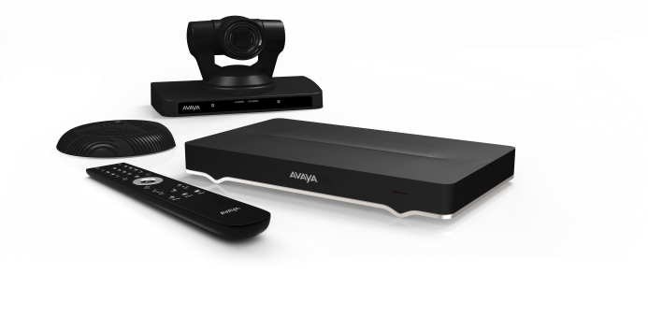
Enhanced Usability Scopia XT Embedded MCU
Participant names
Mute status & active speaker icons
H.264 High Profile & NetSense support
+1 Port with Scopia Desktop (now 9 where before it was 8)
+1 Magic Port

Slide 27
Avaya Scopia V8.3 – Higher Quality
2
Improved audio in virtual rooms
New Voice Activity Detector (VAD) - identifies true speakers and filters out participants with background noise
Dramatically affects automatic gain control, equalizes volumes
Better performance over Internet
Enhanced packet loss handling to fill holes in audio
NetSense bandwidth estimation and dynamic adaptation now on Scopia room systems
H.264 SVC for Scopia Mobile
Lower bandwidth required for mobile devices
H.264 Hi Profile support
Faster presentation response
Lower delay when presenting with Scopia Desktop
Higher quality from Macs
HD 720p video now captured

Slide 28
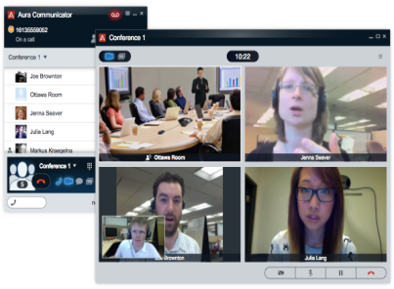
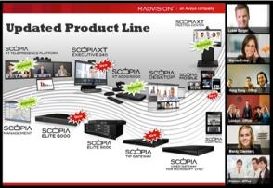
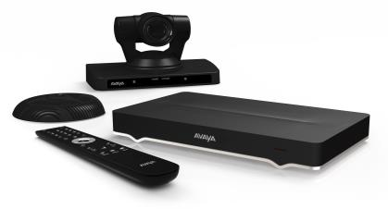
Avaya Scopia V8.3 – Enhanced UC Integration
3
Enhanced UC integration for customers with Scopia and Aura
Flare / Communicator with shared participant list, moderation, combined content and gallery video layouts
Better integration with different Avaya products such as Sipera SBC, Flare, Aura
Higher security within mixed Scopia & Aura environments
Stronger Avaya branding
Avaya name recognition with all popular Scopia products
New Elite 6000 MCU in conference control UI has same “look and feel” of Scopia XT Room systems for ease of use and consistency

Slide 29
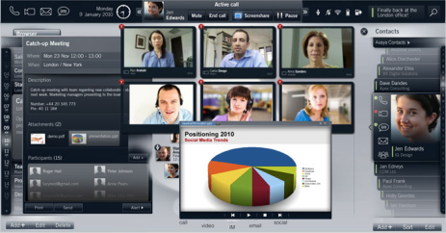
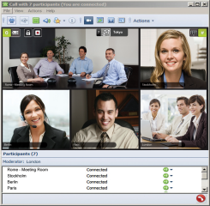
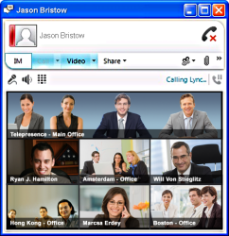
The Highest UC Connectivity Available
Support for:
Avaya Aura
Microsoft Lync
IBM Sametime
ALU MyTeamwork
UC Integration at the Core Provides:
Investment Protection
Interoperability
Notes:
New unified communications solutions promise to bring conferencing to desktop and mobile users; both driving the need for new levels of scalability and device support. Businesses are asking for unified communications solutions that support their current investments in standards-based video conferencing while giving them the flexibility to adopt these emerging solutions.
Radvision offers the most comprehensive and interoperable platform for unified visual communications in the market today including interoperability with Avaya Flare Experience on the Avaya Desktop Video Device and the Avaya one-X Communicator along with other unified communications solutions.

Slide 30
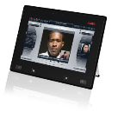
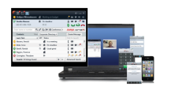
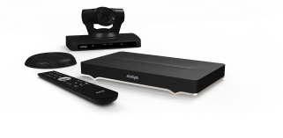
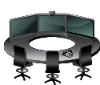
Radvision Connects the World of Video
Room System
Flare / ADVD
ONE-X
XT Series
SCOPIA Mobile
3G
Telepresence
VoIP
VoIP
SIP PBX
VoIP
Notes:
The Radvision Scopia product portfolio is a powerful combination of hardware and software products that is fully standards-based and offers the highest performance available in today’s video conferencing solutions.
Scopia solutions are used by institutions, enterprises, and service providers to create high quality, easy-to-use voice, video, and data collaboration environments, regardless of the communication network – IP, SIP, 3G, 4G, H.323, ISDN or next generation IMS.
Interoperability and interconnectivity is provided between any standards-based video device from any vendor including immersive telepresence systems, video room systems, desktop and mobile video systems, and with solutions from the market leaders in telephony and unified communications.

Slide 31
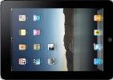
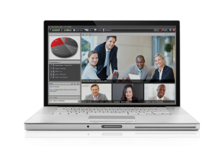
The Best of Both Worlds – Avaya Aura and Scopia Evolution to real-time collaboration at your path, pace and choice
Multi-modal collaboration experience
Very high scale (tens of thousands)
Rich video conferencing
Comprehensive interoperability
p2p
conf
Avaya Scopia
conferencing

Slide 32
Scopia Versus Others? Leading Feature-rich Price-Performance UC-Independent Solution
Dual 1080p 60fps Room | ✗ | ✓ | ✗ | ✓
H.264 High Profile / H.264 SVC | ✗ / Incomplete | ✓ / Incomplete | ✗ / ✗ | ✓ / ✓
iPad Control of Conference | ✗ | ✓ | ✗ | ✓
Embedded Room HD MCU | 4 Sites | 4 Sites | 8 Sites | 9 Sites
Integrated SMB Solution (HD Room, MCU, Desktop, Mobile) | ✗ | ✗ | ✗ | ✓
PC & Mac Application with: (Embedded Firewall Traversal/ Free Distribution) | ✗ / ✗ | ✗ / ✗ | ✓ / ✓ (Messy) | ✓ / ✓
Mobile Application (iOS, Android, Smartphones, Tablets) | Jabber - all WebEx - all | ✓ | ✓ (Messy) | ✓
3rd Party Endpoint Mgmt. | ✓ - Limited | ✓ - Limited | ✓ | ✓
Hybrid Hardware & SW MCU | ✗ | ✗ | ✗ | ✓
3 Screen Telepresence Interop. | Only TIP | Only TIP | Only LifeSize | ✓
Virtualized MCU Resources | Only Scheduled | Only Scheduled or DMA (req. for distribution) | ✗ | ✓ Patented
Microsoft Qualified Gateway | ✗ | ✗ | ✗ | ✓
Price-Performance
✗ Not Supported ✓ Supported
Bad
Great
Notes:
How does the Avaya Scopia® solution stack up against the competition? The short answer is that Scopia is the leading feature-rich, high-performance, UC-independent solution on the market. This table helps you compare some of the details of the Avaya solution with the competition. Avaya has a number of unique capabilities. For example, the room systems have the highest capacity embedded MCU in the market today with the ability to support up to nine sites in a multi-party video collaboration session.
Polycom has made a number of announcements about their support of H.264 SVC; however, it is incomplete. For example, when using SVC with the Polycom MCU, there are the following limitations: participants cannot be invited – only dial-in is supported, no cascading (maximum conferencing size is limited to 60 participants), and content sharing is H.264, 720p – lower resolution and frame rate than Scopia.
With Scopia 8.0, meeting participants can use their iPad or Android device to control conference calls. Mobile users can view up to 28 sites simultaneously on their screen with a Scopia Elite MCU and up to nine sites with an embedded room system MCU. Polycom’s RealPresence Group 700 system is reported to support up to eight sites with the embedded MCU; however, this is only true for standard definition. In high definition, only four sites are supported.
Radvision offers an all-in-one bundle ideal for SMEs. The Avaya Video Collaboration Solution for IP Office provides the ability to host a video conference call with full multi-party HD video and data collaboration for up to eight sites, including a combination of room systems and desktop users both inside and outside an organization. Its fully integrated deployment model doesn’t require detailed technical skills to install or manage. That combined with the unprecedented price point and unique room system capabilities make it ideal for the SME market.
With Scopia Desktop client distribution and licensing, no registration or user-specific licenses are required. So Scopia Desktop and Mobile can be installed on an unlimited number of devices, enabling personal participation from virtually anywhere—even for users outside the organization, such as with customers, suppliers, and prospects. LifeSize is characterized as “messy” for PC, Mac, and mobile applications because LifeSize offers three different software solutions—ClearSea, Connections, and Softphone—that have different interfaces, variable interoperability, and different features, making deployment complicated.
Automatic firewall traversal provides an effective way to extend video communications beyond enterprise boundaries to workers at home and on the road, while maintaining enterprise security measures. Competitors typically do not have firewall traversal built in, and they charge separately for this functionality.
Scopia Management can manage third-party endpoints as well as Avaya, so customers can manage their entire video system from a single management application.
The Scopia Elite 6000 MCU is the industry’s most powerful MCU available. Its unique hybrid software-hardware architecture offers unparalleled video quality while delivering the highest port density available. The Elite 6000 revolutionizes the way transcoded video is processed, doubling the performance of traditional MCUs while reducing energy consumption by half.
The Scopia XT Telepresence Platform combined with the Scopia Elite MCU delivers unmatched interoperability with telepresence systems from Cisco, Tandberg, Logitech/LifeSize, and Polycom, as well as with any standards-based video conferencing system for full video, audio, and content sharing. The Scopia TIP Gateway enables immersive three-screen support in a Cisco TIP environment.
Avaya also has the only Microsoft-qualified gateway for extending standards-based room system video to Lync video users.

Slide 34
Avaya Scopia Use Cases see additional Vertical and Line of Business Scopia Use Case presentations

